Slide 1

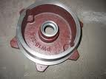
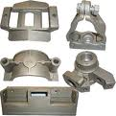
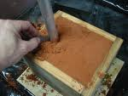
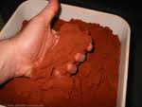
CASTING
Department of Mechanical and Manufacturing Engineering

Slide 2
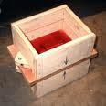
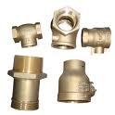
CASTING
A manufacturing process in which molten metal is poured into a mould, having the shape of the desired product, and then allowed to solidify.
Department of Mechanical and Manufacturing Engineering

Slide 3
Casting Process
Pattern making
Mould making
Core making
Metal is heated above its melting point
Molten metal is poured into mould
Metal solidifies and conforms to the shape of the mould
Solidified part is removed from mould
Post casting operations – Cleaning & Machining
Department of Mechanical and Manufacturing Engineering

Slide 4
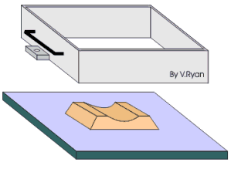
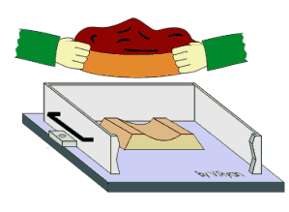
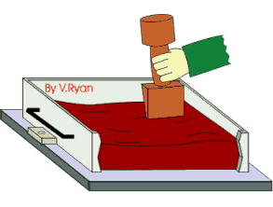
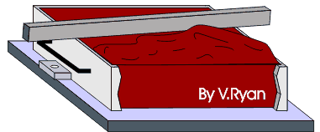
Two Box Moulding Procedure or
Making a Green Sand Mould
Department of Mechanical and Manufacturing Engineering

Slide 5
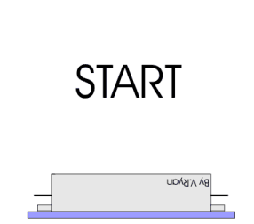
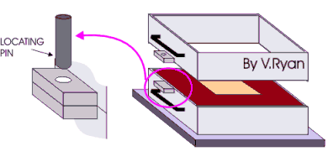
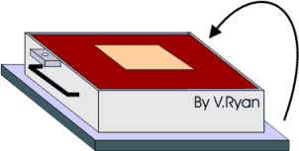
Two Box Moulding Procedure or
Making a Green Sand Mould
Department of Mechanical and Manufacturing Engineering

Slide 6
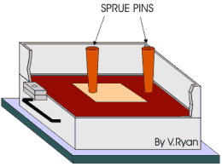
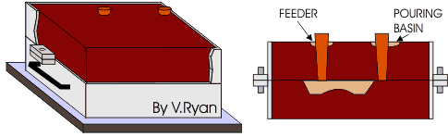
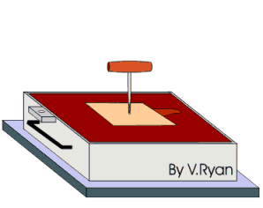
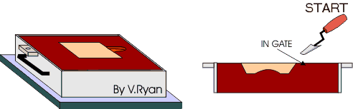
Two Box Moulding Procedure or
Making a Green Sand Mould
Department of Mechanical and Manufacturing Engineering

Slide 7
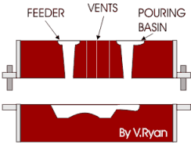
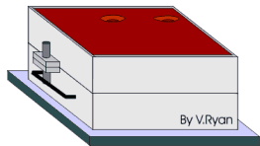
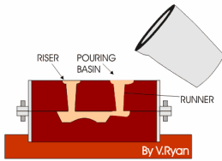
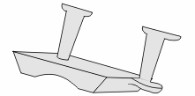
Two Box Moulding Procedure or
Making a Green Sand Mould
Department of Mechanical and Manufacturing Engineering

Slide 8

Two Box Moulding Procedure
Drag
Drag
Drag
Drag
Pattern
Pattern
Molding board
Molding board
Molding board
Molding board
FIRST OPERATION
FIRST OPERATION
Vents
Weight
Pouring basin
Riser pin
Sprue pin
Cope
Riser
Runner
Parting
line
Parting
line
Gate
Core
SECOND OPERATION
COMPLETE MOLD

Slide 9
Two Box Moulding Procedure
First the drag is placed in the upside down position on the moulding board, and the bottom half of the pattern is placed centrally inside the drag.
The drag is completely filled with molding sand. The sand is rammed around the pattern. After ramming the excess sand is leveled off with a strike rod.
The drag is then turned over and the cope is placed on the drag. The upper half of the pattern is placed over the bottom half of the pattern. Two sprue pins are placed on either side of the pattern.
These pins which are withdrawn later from the cope leave two passages known as the runner and riser. Runner is used for pouring the molten metal into the mould and riser will ensure that the mould cavity has been filled up.
Department of Mechanical and Manufacturing Engineering

Slide 10
Two Box Moulding Procedure
After that cope is filled with moulding sand and is properly rammed. Excess sand from the top surface is removed and vent holes are made to provide for the escape of hot gases.
The sprue pins are withdrawn, a funnel shaped opening is scooped out at the top surface near the runner to form the pouring basin. The cope is lifted from the drag and is placed separately with its parting surface in the upward position. Next both the halves of the pattern are withdrawn and a gate is cut in the drag to connect the runner to the mould cavity.
Department of Mechanical and Manufacturing Engineering

Slide 11
Two Box Moulding Procedure
If a core is used , using the core box and core sand the core is separately made and placed in position in the drag. The cope is then placed in position over the drag so that the mould is closed. The two boxes are then clamped with each other. Before pouring the molten metal a weight is placed over the cope to prevent the metal from flowing at the parting surface.
After the molten metal solidifies the casting is withdrawn by collapsing the sand, the runner and riser extensions are sheared using a saw and cleaning and machining operations are carried out to finish the casting.
Department of Mechanical and Manufacturing Engineering

Slide 12
Molding Sand Composition
The main ingredients of moulding sand are:
Silica sand (75%) – Constitutes the major ingredient, gives high temperature withstanding ability to the moulding sand.
Binder(8 – 15%) - Clay is the most commonly used binder. It imparts necessary bonding strength to silica sand grains.
Moisture(6 – 8%) - Clay acquires its bonding action only in the presence of the required amount of moisture or water.
Additives(5%) – Additives such as limestone, soda potash, magnesia, certain oils etc. enhance the properties of the moulding sand.
Department of Mechanical and Manufacturing Engineering

Slide 13
Properties of a Molding Sand
The desirable properties possessed by moulding sand are
1. Permeability or Porosity
2. Refractoriness
3. Adhesiveness
4. Cohesiveness
Flowability
6. Collapsibility
Department of Mechanical and Manufacturing Engineering

Slide 14
Properties of a Molding Sand
Porosity (Permeability)
Permeability is the property of the moulding sand which permits the escape of steam & other gases generated during pouring & solidification of metal.
Permeability depends upon sand grain size, percentage of clay and extent of ramming. In general larger grain size, softer ramming and lesser clay percentage increases permeability.
Moulding sand having insufficient porosity can result in the formation of blow holes in the casting.
Department of Mechanical and Manufacturing Engineering

Slide 15
Properties of a Molding Sand
Refractoriness
It is the ability of the molding sand to withstand the high temperature of the molten metal when poured, so that it does not get fused with the metal.
Moulding sand possesses this property due to the presence of silica in it. Higher the percentage of silica greater will be the refractoriness.
Adhesiveness
It is that property of the sand because of which it is capable of adhering to the surfaces of other materials. It is due to this property the rammed sand mass sticks to the surfaces of the moulding boxes and does not fall when the boxes are lifted and placed upside down.
Department of Mechanical and Manufacturing Engineering

Slide 16
Properties of a Molding Sand
Cohesiveness
Ability of sand particles to stick together.
Should be sufficient to permit the mold to form the desired shape and retain it’s shape even after the hot metal is poured in the mold
Flowability
Ability of the sand to behave like a fluid so that when rammed it will flow to all portions of a mould and around the pattern to take up the required shape. Flowability increases as clay & water content increase.
Department of Mechanical and Manufacturing Engineering

Slide 17
Properties of a Molding Sand
Collapsibility
Ability of sand to collapse as the molten metal solidifies so that during the contraction of the solidified casting it does not provide any resistance which may result in cracks in the castings.
Department of Mechanical and Manufacturing Engineering

Slide 18
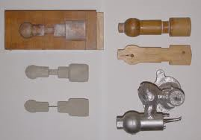
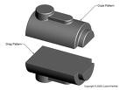
PATTERN
A pattern is a replica of the casting to be made.
Using pattern, impressions or mould cavity can be formed in the moulding sand.
Department of Mechanical and Manufacturing Engineering

Slide 19
Pattern materials
Wood
Easy to work, cheap & readily available
Can take up any shape easily and is light in weight
Disadvantage is it is readily affected by moisture and wears out quickly as a result of sand abrasion.
Metal
Do not change their shape when subjected to moist conditions
Used when the castings are large in number
High surface finish and dimensional accuracy
High cost, greater weight and tendency to rust
For mass production.

Slide 20
Pattern materials
Plastics
Do not absorb moisture, light in weight and have a very smooth and glossy surface.
Because of their glossy surface they can be withdrawn from the mould very easily without injuring the mould.
Plaster
Easy to prepare but not durable, gets affected by moisture & hard ramming.
Intricate shapes can be easily made.
Department of Mechanical and Manufacturing Engineering

Slide 21
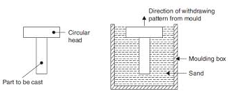
Single piece pattern.
A pattern which is made without any joints, partings or loose pieces in its construction is called a single-piece or solid pattern. This is the simplest of all the patterns and is generally contained only in the drag during the moulding process.
Department of Mechanical and Manufacturing Engineering

Slide 22
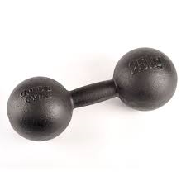
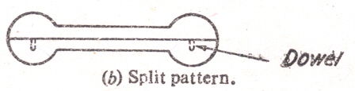
Split pattern
Used whenever the casting has a contour or irregular shape.
Parting line of the pattern forms the parting line of the casting.
Dowel pins are used for proper alignment.
The lower half is contained in the drag and the upper half in the cope
EX: Spheres, dumbbells
Department of Mechanical and Manufacturing Engineering

Slide 23
Pattern Making Allowances
Shrinkage Allowance
Machining or Finishing Allowance
Draft or Taper Allowance
Shake or Rapping Allowance
Camber or Distortion Allowance
Mould Wall Movement Allowance
Department of Mechanical and Manufacturing Engineering

Slide 24
Shrinkage Allowance
As the molten metal cools and solidifies it shrinks and contracts in size. If the pattern is of the same size as that of the desired casting, then the resulting casting would be smaller in size as compared to the desired size.
To compensate for this the pattern is made larger than the desired casting so that the solidified casting conforms to the required size.
Different metals have different shrinkage rates.
The pattern maker uses a pattern makers scale in which the graduations are oversized by a proportionate amount to compensate for the shrinkage of the metal.
Department of Mechanical and Manufacturing Engineering

Slide 25
2. Machining Allowance
When the solidified casting is withdrawn from the mould it has a rough surface contaminated with sand particles. This will have to be removed by machining in order to improve the surface finish and to bring the casting to the required dimensions.
This extra amount of metal which has to provided on the surfaces, that is to be machined off is called machining allowance.
The amount of this allowance depends upon the method of machining to be employed, size and shape of the casting and the degree of finish required on the surface.
Department of Mechanical and Manufacturing Engineering

Slide 26
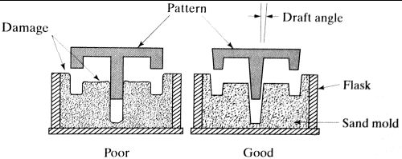
3. Draft or Taper Allowance
When the pattern is withdrawn from the mould there is always a possibility of damaging the vertical surfaces and edges of the mould.
This difficulty can be overcome if the vertical surfaces of a pattern are tapered slightly which is known as draft allowance.
It facilitates easy withdrawal of pattern from the mould. It may be expressed either in degrees or in terms of linear measures.
Department of Mechanical and Manufacturing Engineering

Slide 27
4. Rapping Allowance
While withdrawing the pattern from the mold by striking over it the size of the cavity increases.
To compensate for this a negative allowance is provided in the pattern by making it smaller than the actual size.
However it may be neglected for all practical purposes in small and medium sized castings.
Department of Mechanical and Manufacturing Engineering

Slide 28
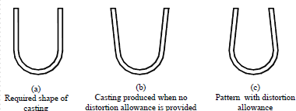
5. Distortion Allowance
Some castings because of their size and shape tend to get distorted during solidification period due to the thermal stresses developed in them.
The shape of the pattern is thus bent in the opposite direction to overcome this distortion. This is called distortion allowance
Department of Mechanical and Manufacturing Engineering

Slide 29
6. Mould Wall Movement Allowance
Mould wall movement takes place because of excessive heat and pressure applied by the molten metal on the surface layer of the sand which affects the size of the casting.
Remedy:
  Provide proper allowance in the pattern
  Controlling the density & temperature of molten metal
  Controlling the composition of the molding sand
Department of Mechanical and Manufacturing Engineering

Slide 30
Cores in the Mold Cavity
The mold cavity provides the external surfaces of the cast part
In addition, a casting may have internal or hollow surfaces, which is determined by a core, placed inside the mold cavity to define the interior geometry of part
Since cores are subjected to severe conditions they must be strong enough to resist erosion by the molten metal, must have adequate permeability, should be highly refractory in nature and must have good collapsibility to minimize strains on the casting and to facilitate their removal from the casting.
Department of Mechanical and Manufacturing Engineering

Slide 31
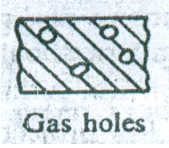
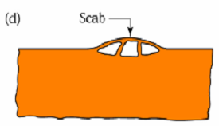
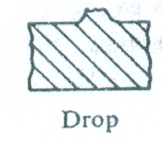
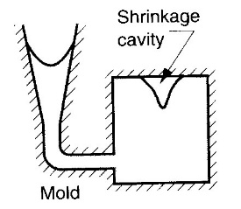
Defects in casting
Blowholes
  Smooth round holes appearing as a group of small holes below the surface of casting
  Due to entrapped bubble of gases
Scabs
  Projection on the casting that occur when a portion of the mould lifts and metal flows.
Drop
  Occurs when upper surface of the mold cracks and pieces of sand fall in to the molten metal
Shrinkage cavity
  Void created in the casting mainly due to uncontrolled
  solidification of the metal
Department of Mechanical and Manufacturing Engineering

Slide 32
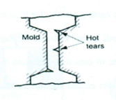
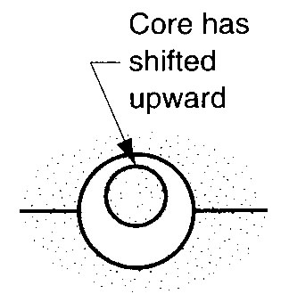
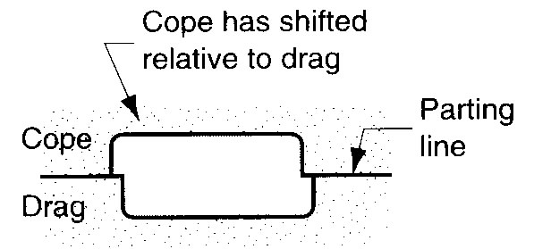
Hot Tears
-They are internal or external cracks having ragged edges occurring immediately after the metal has been solidified
Shifts
  An external defect caused due to core misplacement or mismatching of top and bottom parts of the casting
Fin
  A thin projection of the metal, caused due to incorrect assembling of molds or cores.
Swell
  Enlargement of metal cavity by metal pressure, caused by improper ramming.
Department of Mechanical and Manufacturing Engineering

Slide 33
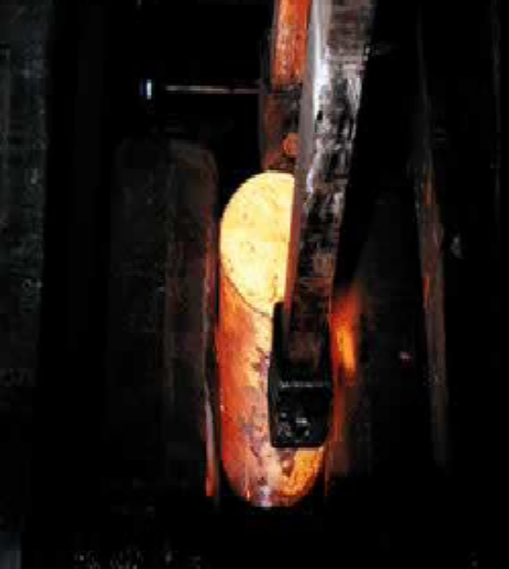
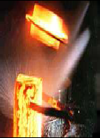
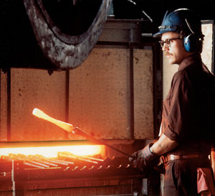
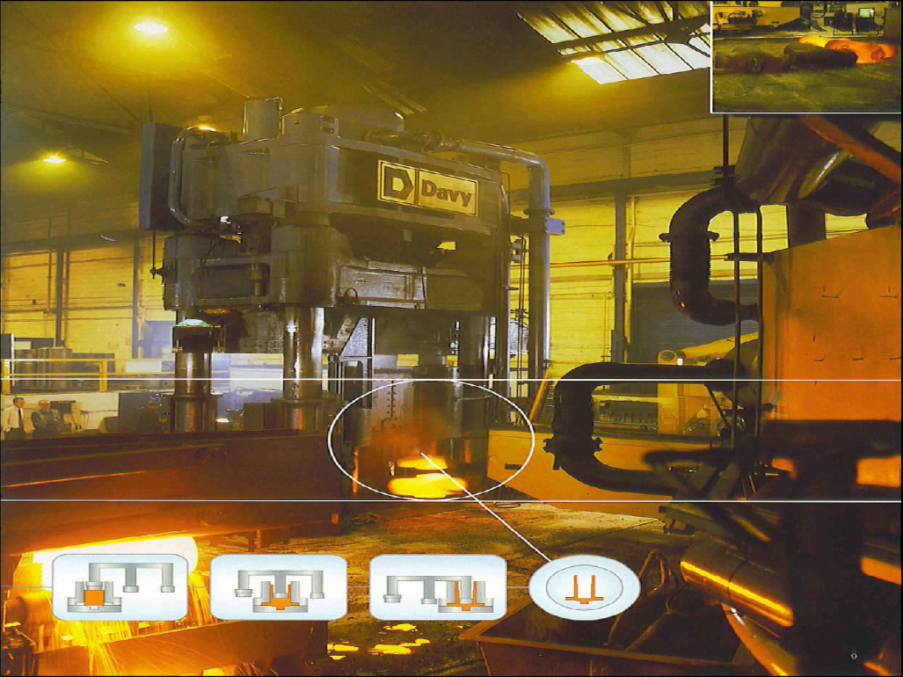
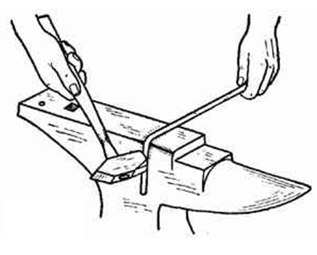
Forging
Department of Mechanical and Manufacturing Engineering

Slide 34
Forging
Forging involves heating a metal stock to a desired temperature, enabling it to acquire sufficient plasticity, followed by operations such as hammering, bending, pressing etc. to give it the required shape. These operations can be carried out either by hand hammers or by power hammers.
Department of Mechanical and Manufacturing Engineering

Slide 35
Smithing is a hand forging operation wherein small parts are produced by heating the metal stock in an open fire or hearth and then working on it with hand hammers to give the desired shape.
Forging involves heating the metal stock in a closed furnace and working on it with the help of power driven hammers to give the desired shape. It is generally used in the production of heavy parts
Department of Mechanical and Manufacturing Engineering

Slide 36
Characteristics of Forging:
Forging refines the structure of the metal by smashing up large grain formations and closing up any cavities that may be present in the metal.
In forging the grains rearrange themselves according to the shape of the object hence, forged components exhibit directional properties indicated by the flow lines which increases the strength of the component.
In forging certain mechanical properties, resistance to shock and vibration are improved and cracks and blow holes are welded up, hence the component will be free from internal defects
Department of Mechanical and Manufacturing Engineering

Slide 37
Characteristics of Forging:
Forging produces poor surface finish due to scale or oxide formation at high temperatures with the result the dimensional accuracy of the components is difficult to maintain.
Forging is a costlier process requiring expensive tools and dies, hence it is suitable only for mass production work.
Department of Mechanical and Manufacturing Engineering

